Slide 1
Cadence/Referral Updates
Practice Manager Meeting
5/3/21

Slide 2
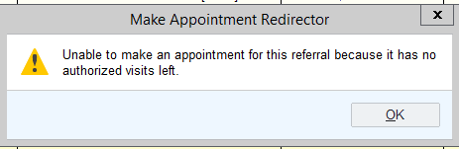
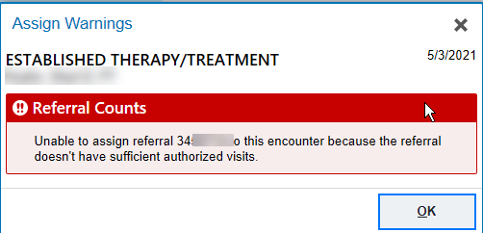
Referral Warnings- no authorized visits
Prevent scheduling using a referral without any remaining visits
Staff unable to by-pass

Slide 3
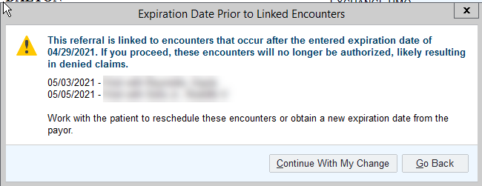
Referral Warning- expiration date
Scheduling using a referral past expiration date
Prompts appear for scheduling as well as when expiration date changed and referral is attached to visit
With advanced security (majority of staff), this can be overruled

Slide 4
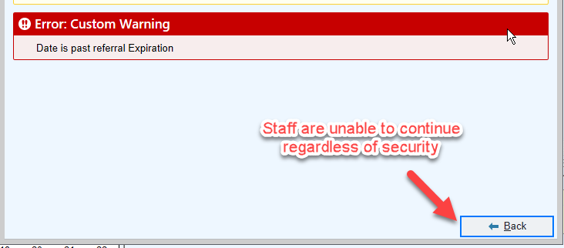
New Referral Warning
If the referral is in an authorized status and these prompts are overruled, payment could be lost and/or write-offs could occur
Add new referral warning that can not be by-passed

Slide 5
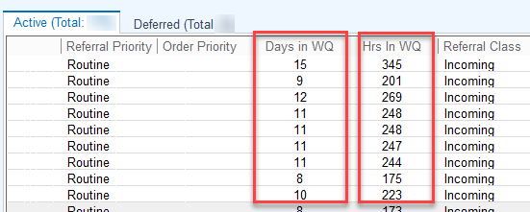
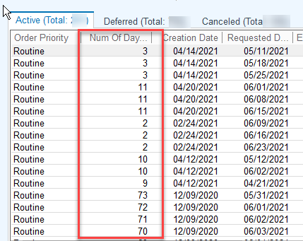
Referral Aging
Two new columns have been added to track days or hours in referral WQ
For example: If a referral was on the WQ for 12 days, then the appt was scheduled, it then falls off WQ
  If the appt is cancelled or NOS, then comes back to the WQ and numbering starts back over
Available in Referral and Appt Request WQ

Slide 6
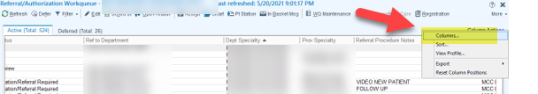
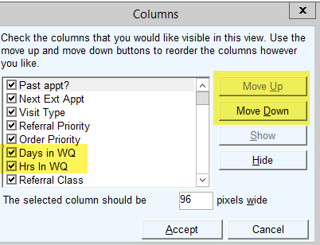
Add to Your Referral View
Click on column right hand corner of your WQ
Chose the column you wish to add or mov and use your Move Up or Move Down choices

Slide 7
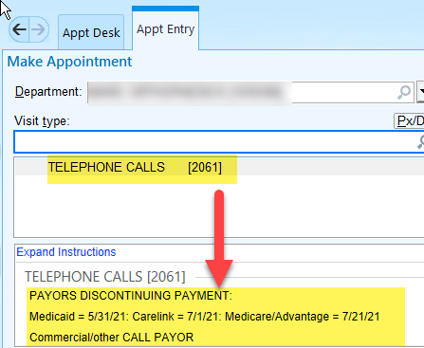
Telephone Calls
In anticipation of telephone calls no longer being covered by some payors: add VT instructions as a reminder for staff
Require VT to flag for a referrals
  BC pre visit review to ensure payment is or will be covered

Slide 8
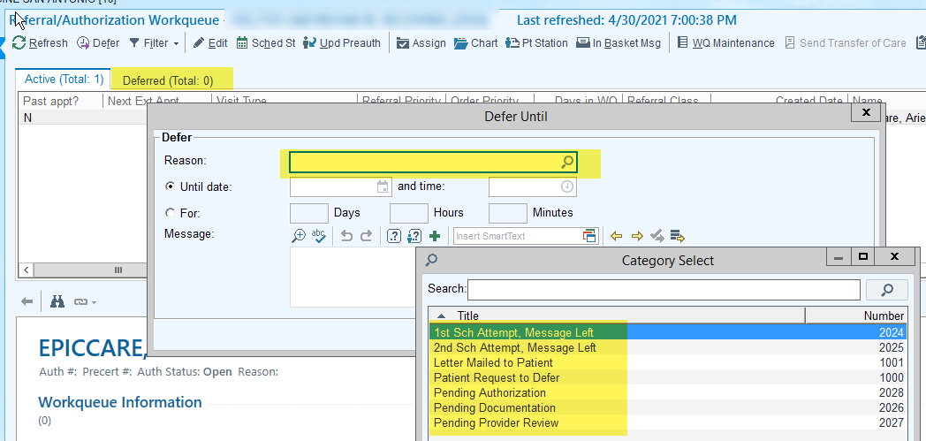
New Referral Deferred Reasons

Slide 9

If You Need Assistance of Have Questions
Submit help desk ticket to Cadence
  Be sure to provide
    specific question/issue
    provide examples such as screenshots
    Thank you

